Slide 1
State Health Benefit Plan
Site Coordinator Training Kyle Cheuvront 1/30/25 & 1/31/25
Notes:
Introduce yourself and the training - Let them know Tiffany with Quest is on the call
Ask to hold questions until the end
Insure everyone mutes themselves and doesn’t place you on hold

Slide 2
Implementation Phases
Preparation
Roles & Responsibilities
Eligibility & Incentives
Execution
Scheduling Onsite Screenings
Participant Launch
Site Coordinator Onsite Screening Preparation
Participant Onsite Screening Experience
Alternative Screening Options
Closing
Site Coordinator Survey
Notes:
Introduce the presentation
Today we’ll be going over the different phases of hosting an onsite screening: prep, execution, and closing

Slide 3
Preparation: Roles & Responsibilities
Notes:
We’ll start off with the different roles involved and what the responsibilities are for each role

Slide 4
Understanding Roles: Sharecare Event Specialist
Day-to-day point of contact for screening-related questions
Responsibilities:
Work with vendors to establish expectations and ensure each implementation runs smoothly
Create and manage screening project timelines
Educate Site Coordinators on screening implementation
Facilitate communication with our screening partner, Quest Diagnostics
Communicate screening-related information to Site Coordinators
Answer questions and assist with participant issues
Assess and confirm that each site is prepared to host a screening
Notes:
Explain event specialist role
Again my name is Kyle and I am your Sharecare Event Specialist
I work with our vendor to make sure each event set up runs smoothly
I create and manage the project timelines, and educate site coordinators on the implementation process
I facilitate communication between our screening partner, Quest diagnostics, and the site coordinators
Answer questions and help with individual participant issues
As well as confirming that each site is prepared to host a screening
My contact information is included on the last slide of the presentation so please feel free to reach out anytime with questions you may have

Slide 5
Understanding Roles: Site Coordinator
Site Coordinators serve as their location’s wellness leader by encouraging participants to become involved and excited about the Be Well SHBP® well-being program
Preparation
Submit request for scheduling via the webform and communicate with Quest via email to finalize event details
Reserve screening location within facility
Execution
Encourage sign-ups
Print sign-in sheet and provide to the Quest team before event
Note: Quest does not complete site visits before events
You are already promoting health and wellness by hosting a biometric screening event why not become a
Well-Being Ambassador! You will continue to promote healthy habits while also getting the chance to win
contests and awards and receive recognition for your efforts. To find out more about the program and to apply, visit www.BeWellSHBP.com
Notes:
Discuss roles of the site coordinator
The site coordinator helps encourage participation in the Be Well SHBP program and screenings
You will submit the request from the webform and work with Quest to finalize event details, as well as reserving a location at your site to hold the screening
Encourage signups
Print sign in sheets
*May be different from previous years/vendors, but Quest does not complete site visits before events
If you are interested in becoming a Well-Being Ambassador, go to the BeWellSHBP website to find out more information about the program and apply

Slide 6
Understanding Roles: Onsite Screening Vendor – Quest Diagnostics
Quest Diagnostics
Contacts Site Coordinator to schedule screening dates/times
Provides examiners for screenings
Brings all screening supplies on the day of each event
Examiners
Attend onsite screenings to collect the biometrics and blood results
Notes:
Introduce Quest and explain their role
Quest diagnostics is our vendor partner for screenings
The quest team will contact the SC to schedule and finalize screening dates and times
They make sure there are enough staff and supplies for your screening, and brings the screening supplies with them the day of the event
The Quest Examiners at the screening collect the biometric measurements and blood results for the participants
Again, Tiffany from our Quest team is on the call today if you have any specific Quest questions at the end of the presentation

Slide 7
Preparation: Eligibility & Incentives

Slide 8
Eligibility & Incentives
Who’s Eligible?
The 2025 SHBP-sponsored screening events are open to all SHBP members and their covered spouses enrolled in Anthem Blue Cross and Blue Shield (Anthem) or UnitedHealthcare (non-Medicare Advantage) Plan Options. Kaiser will attend select events and will be able to screen their members at those events.
The 2025 incentives do not apply to dependent children or members enrolled in Kaiser Permanente or Medicare Advantage Plan Options.
What’s the Incentive?
As part of the Be Well SHBP well-being program, members will earn 120 points for taking the 2025 RealAge® Test and 120 points for completing a biometric screening.
Note: Points cannot be awarded until completion of the 2025 RealAge Test.
Members and their covered spouses may also earn up to an additional 240 points by completing well-being coaching, online challenges, and preventive screenings.

Slide 9
Execution: Scheduling Onsite Screenings

Slide 10
SHBP-sponsored Onsite Screening Events
Screenings will occur between March 1st - October 31st 2025
You must have 40 or more registered participants by your lockdown date 2 weeks before your event by 4pm ET to host an event
Standard Screening hours: Monday-Friday 7:00a.m.-7:00p.m. ET
Screening dates, times and locations are scheduled and confirmed prior to the event
Quest will provide examiners and registration clerk
One examiner can screen 4 participants per hour
The screening hours and number of examiners depend on how much space is available and how many participants have scheduled appointments
It is recommended but not required to fast before the screening event in order to receive the most accurate results
Morning screenings are encouraged

Slide 11
Safety Guidelines
To ensure the safety of everyone, we have updated our event guidelines as follows:
Quest providers cannot come to work sick and/or experiencing symptoms.
All equipment, including tables and chairs, provided for the specimen collection at on-site events are disinfected after each participant.

Slide 12
Marketing – Screening Support Documents
Marketing items can be found here:
www.BeWellSHBP.com/screenings--support
These include:
Screening FAQ Flyer
Screening Site Coordinator Checklist
Email templates to send to SHBP members to help encourage sign ups
Event Promotional Posters
Directional Arrow Signs
Screening Room Signs
Notes:
Marketing items for promoting and preparing for your events can be found on the BeWell website. If you have any questions leading up to your event feel free to reach out to me. My email address is listed at the end of the presentation.

Slide 13
Execution: Participant Launch

Slide 14
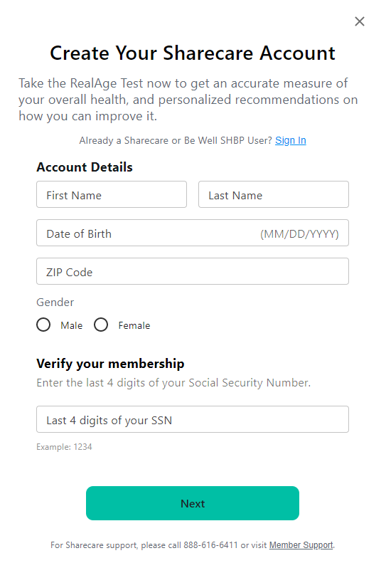
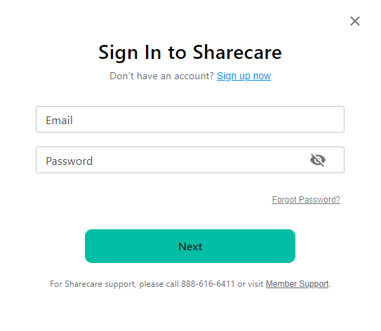
Accessing Quest Scheduler
Participant Login:
New Users: Register here
Existing Users: Log in here
Notes:
Participants will access the scheduler through the Sharecare platform.
If they are a new user they will need to register for an account
If they registered previously, they can sign in using the same credentials
These are live links that will take you to the registration and sign in pages, so feel free to refer back to this if you need to access the links

Slide 15
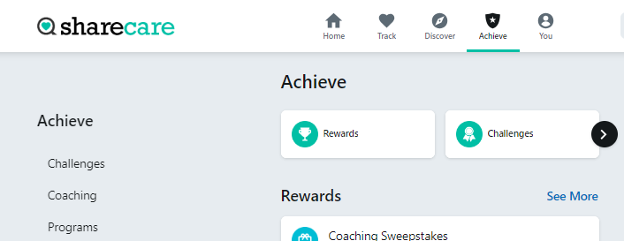
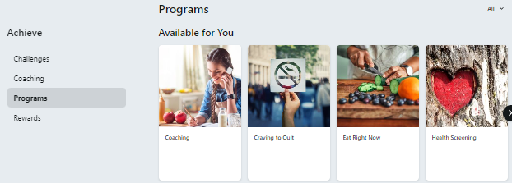
Accessing Quest Scheduler
Members can access the Quest Scheduler by logging into their Be Well account on the Sharecare Platform. Once logged in, select the Achieve icon, and then the Programs tile. Next select the Health Screening tile to be taken to the Quest online scheduler.
Notes:
Once they’ve signed in to their BeWell account on the Sharecare app or platform, they can access the Quest scheduler by selecting the Achieve icon, then the programs tile. The health screening tile will then show up and they will select that to be taken to the scheduler

Slide 16
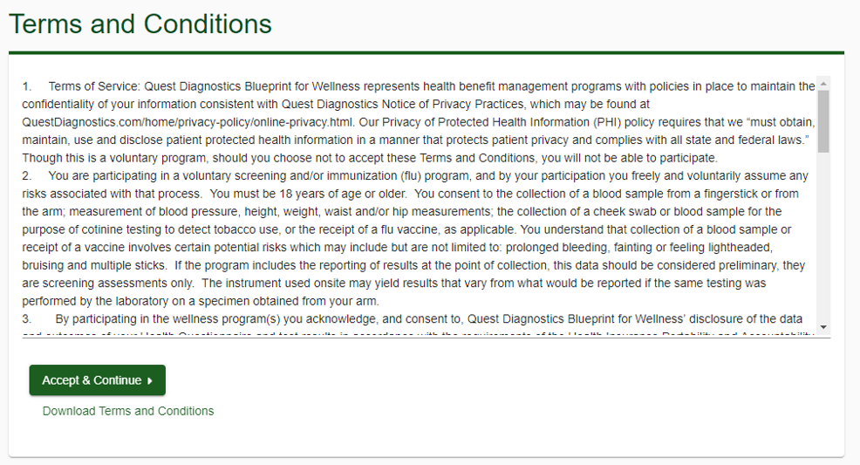
Quest Scheduler
Members will review the Terms and Conditions and click Accept & Continue

Slide 17
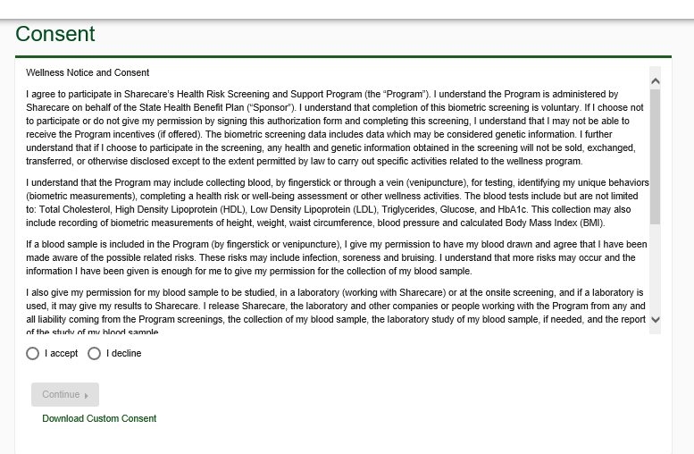
Quest Scheduler
Members will review the Consent, click I accept and then Continue

Slide 18
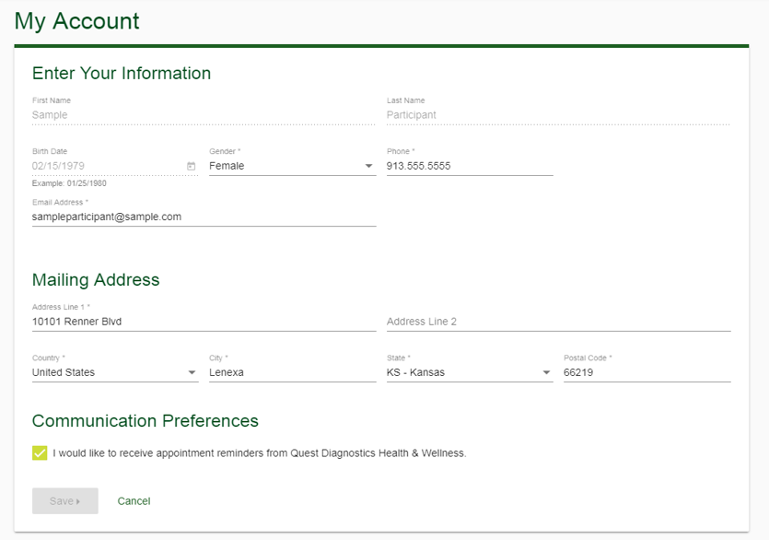
Quest Scheduler
Members will confirm all their information is correct, select their communication preferences, and click save

Slide 19
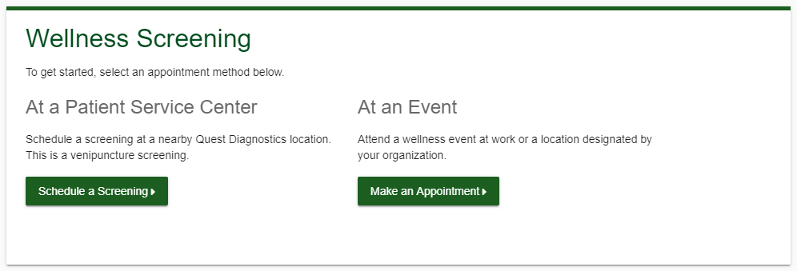
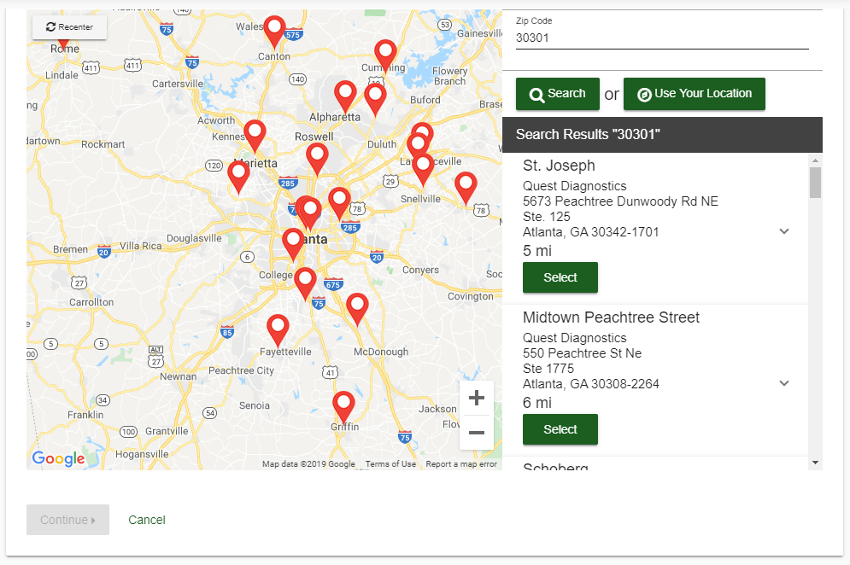
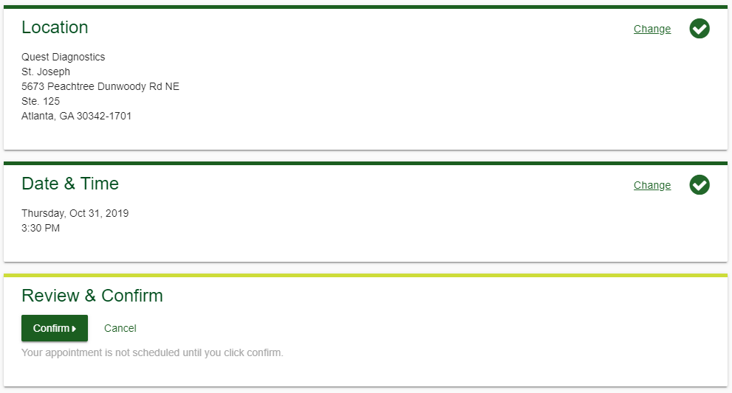
Quest Scheduler
After confirming their information is correct, participants will be taken to the Quest dashboard
Participants will click their desired Biometric Offering (Onsite Screening Event or Patient Service Center) and follow the steps below:
Choose location and click “Continue”
Select date & time of appointment
Review selected appointment and click “Confirm”
Notes:
**Note the PSC is a venipuncture screening and Onsite is fingerstick

Slide 20
Lockdown Process
What is a Lockdown?
14 calendar days prior to each event, the number of appointments scheduled must be locked down at 4p.m. ET
Confirms estimated number of participants
Why a Lockdown?
An accurate estimate of participants ensures appropriate amount of supplies and examiners for screenings
Key Points
SHBP-sponsored screening events will only be held at locations with 40 participants or more signed up by 4pm ET on your lockdown date.
If you have LESS than 40 scheduled appointments 3 weeks prior to your event, your Sharecare Event Specialist will notify you and ask that you help increase participation
If you estimate over 40, but have less than 40 scheduled appointments at the 14 calendar day lockdown, your event may be cancelled
Notes:
Make sure you over-state that they can not change the estimate after the lockdown date. Tell them scheduling is still open until the day before, but they can’t change the estimate.

Slide 21
Execution: Site Coordinator Onsite Screening Preparation

Slide 22
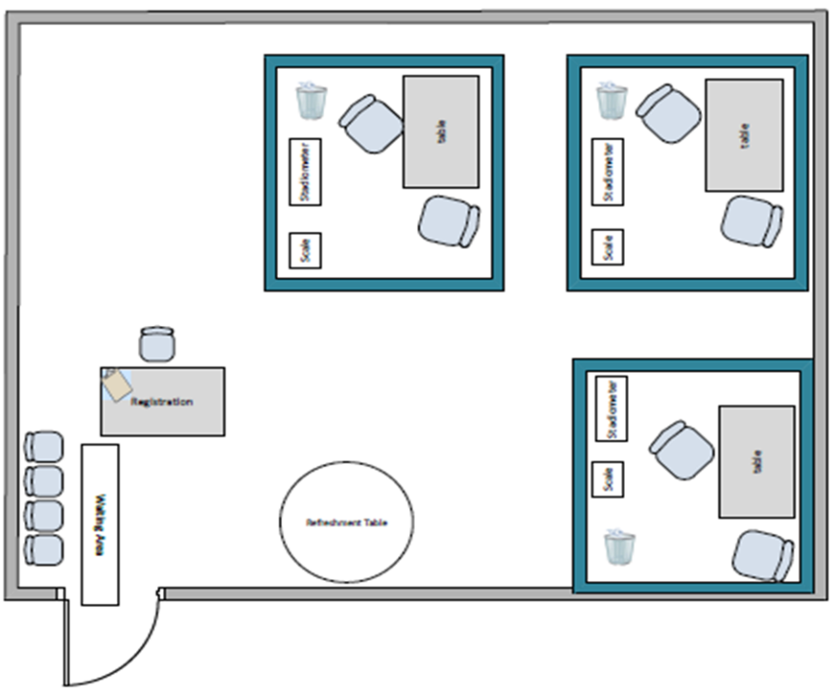
Day Before the Screening – Prepare Screening Area
Participant Registration Area
Outside but near the screening rooms
Table and chair for registration desk
Need 1 chair per registration station
Exam Stations
Each examiner station will require a space of 8 ft. x 8 ft.
Day of event Screening Vendor arrives one (1) hour prior to start time to set up screening area
1 table, 2 chairs, and a trashcan for each exam station
Due to OSHA regulations, we cannot host screenings in a cafeteria if food is being prepared or consumed at the time of the screening

Slide 23
Day Before the Screening – Final Prep
Get your materials ready!
Ensure your registration and screening areas are set up appropriately
Ensure you have all the items ready to go the next morning
Prepare your screening sign-in sheets – make sure you bring them the morning of the screening – Your Sharecare Event Specialist will provide your final sign-in sheet the week before the event
Blue or Black Pens
Set reminders!
Set a reminder to arrive one (1) hour before screening start time the morning of your screening to greet the Quest event team and direct them to the screening area.
Notes:
Sign in sheets will be emailed to the site coordinator the week before your event. Please filter down to your location, print, and have ready for the Quest team when they arrive.

Slide 24
Execution: Participant Onsite Screening Experience

Slide 25
Onsite Screening – Participant Experience
Fingerstick
Fasting is recommended but not required:
Biometrics: Height, weight, waist circumference, BP
Labs: HDL, LDL, Total Cholesterol, Triglycerides, Glucose, and HbA1c
Participant Experience:
Participants will visit Registration and state their name and appointment time
They will be directed to an available Exam Station to provide their electronic signature on the examiner tablet acknowledging that they have read, understand and agree to the Informed Consent and Release. Biometric measurements will be taken first, then the finger prick will be completed
Participants are asked to sign off electronically that they agree with the measurements/blood values recorded for them on the examiner tablet.
Participants have the right to have their body measurements retaken. The last result taken will be used.
If applicable, examiner will highlight out-of-range values
If a member has a “critical value” reading, examiner will recommend that the member seek medical attention and sign a form saying they accept or refuse the recommendation
Participants will complete a quick survey about their experience at the onsite screening and return it to registration
Screening process takes about 15 min per participant

Slide 26
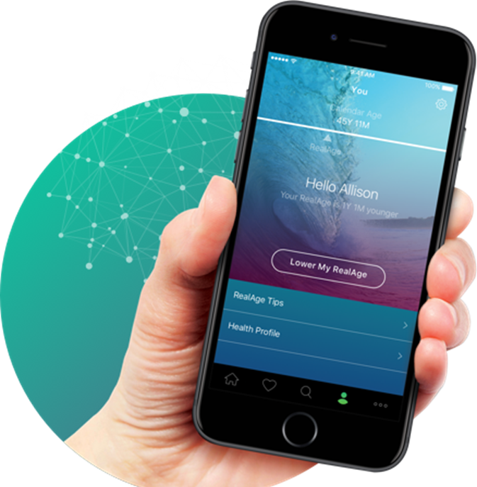
Participant Screening Rights
All participants have the right to review their biometrics
If a participant disagrees with a measurement, they may ask the examiner to take the measurement again. The 2nd measurement will be used to update the participant’s report
Participants may ask questions and voice any concerns they have to the examiner who screens them

Slide 27
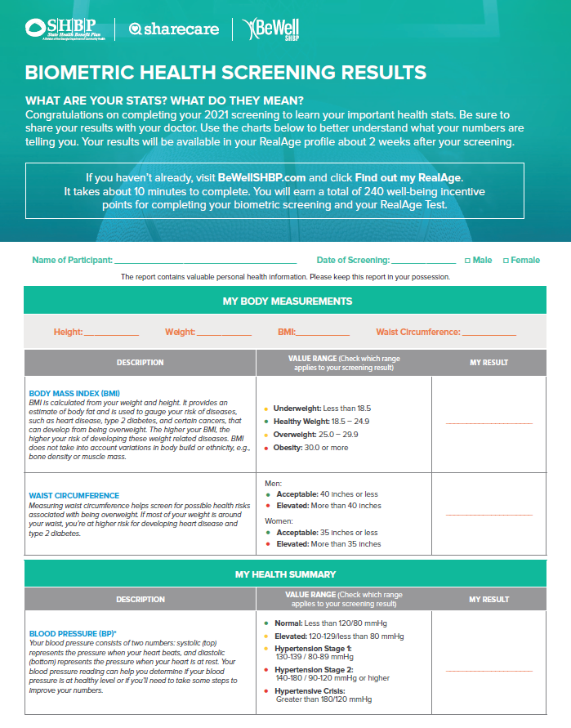
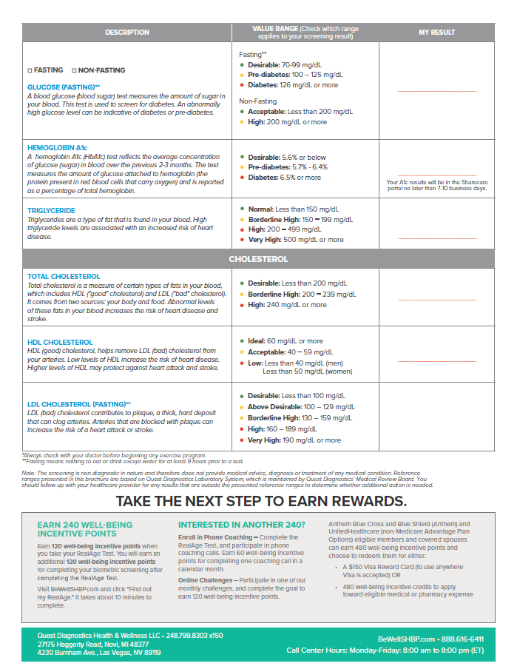
Handout at the Screening event
A “Know Your Numbers” one-pager will be provided to each participant
The Quest staff will bring these forms with them, fill in the results and provide them to each participant after they complete their screening

Slide 28
What if there are issues during the event?
Materials not on site
Provider
no-show
Unsatisfactory provider performance
Please contact Sharecare at BeWellSHBP.Events@Sharecare.com immediately

Slide 29
Walk-in Policy
We do not recommend walk-ins and ask that everyone signs up for their appointment in Quest’s Scheduling Tool
If a participant does wish to screen as a walk-in, they will take 2nd priority to those signed up
If someone arrives earlier than their scheduled appointment (more than 10 minutes before), they may be asked to return at their scheduled appointment time
Any participant who is a walk-in MUST bring their medical ID card to ensure we are screening only those who are eligible
Notes:
**Bring up If you anticipate walk-ins, they need to be accounted for in your final estimate on the lockdown date!!**
If a participant does wish to screen as a walk-in, they will take 2nd priority to those with a scheduled appointment
The registration clerk may find an open appointment time and ask them to return at that time to be screened.
This ensures that there are no more than 10 people in the event area at a time

Slide 30
Execution: Alternate Screening Options

Slide 31
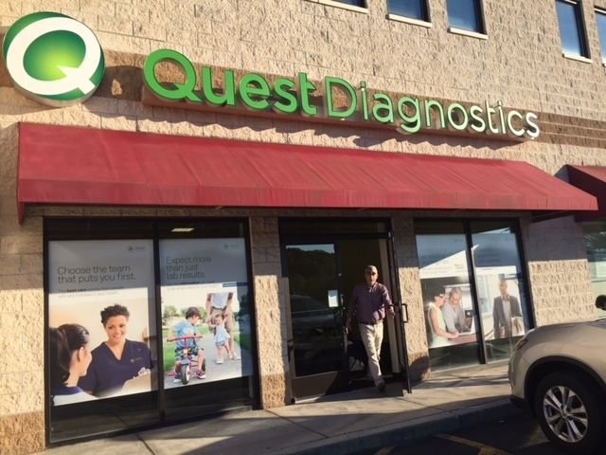
Patient Service Center - Participant Experience
Participants will visit the PSC where they scheduled their appointment.
They will check in on the tablet provided at the registration desk.
The provider will escort them to the exam room and then will proceed with the body measurements and blood collection.
Body measurements are completed before the Venipuncture Blood Draw (this will also now test for HbA1c)
Fasting is preferred, but non-fasting participants can still participate
Participants are asked to sign off that they agree with the body measurements recorded for them.
Participants have the right to have their body measurements re-taken, but the last measurement will be used
Notes:
If a participant chooses to complete their Biometric offering at a Patience Service Center, once they have scheduled their appointment they will go to the PSC where they scheduled their appointment.
Participant will check in on the tablet provided at the registration desk.
The provider will escort the participant to the exam room and then will proceed with the body measurements and blood collection.
Body measurements are completed before the Venipuncture Blood Draw
Fasting is preferred, but non-fasting participants can still participate
Participants are asked to sign off that they agree with the body measurements and blood values recorded for them.
Participants have the right to have their body measurements re-taken, last result taken will be used

Slide 32
2025 Physician Screening Form
Participant Experience
Participants access the 2025 Physician Screening Form link from www.BeWellSHBP.com
Participants will log in using first name, last name, date of birth, zip code and gender
Participants will check the box agreeing to Terms & Consent
Four-page 2025 Physician Screening Form appears
Provider cover letter
Instruction page
Pre-populated physician screening form
Terms and Consent
Participants take form to their physician and the physician completes biometrics and enters blood results from physical
Participant or their physician will return the physician form (fax, mail or online submission) between January 1 and December 1, 2025
It is the participant’s responsibility to ensure the form is received by Sharecare by December 1, 2025
Form is processed and data is transmitted to Sharecare and loaded into the wellness portal
Once the form is received, participants who provided their email address during the download process will receive an email notifying them either that their form was processed or there are issues with the form that need to be corrected and the corrected form needs to be resubmitted
Emails will come from noreply@wisetrend.com

Slide 33
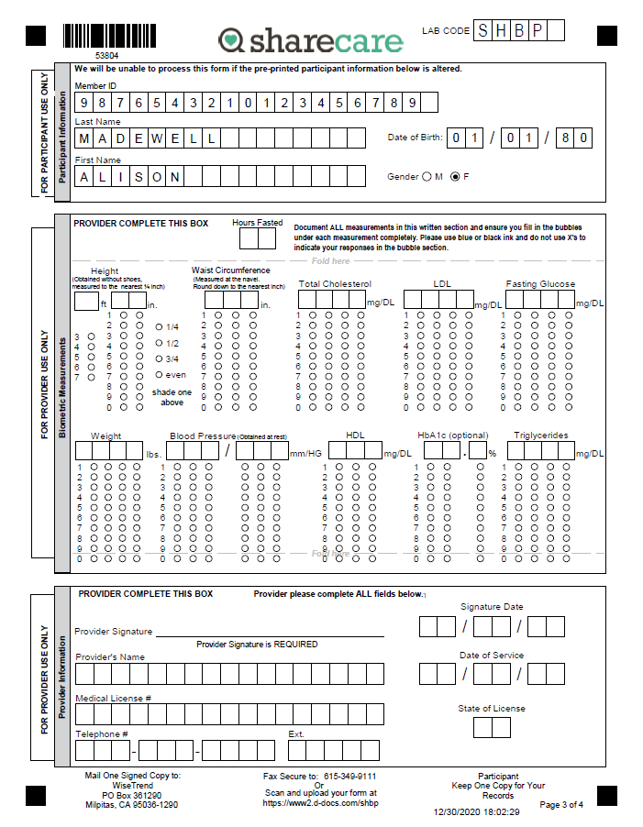
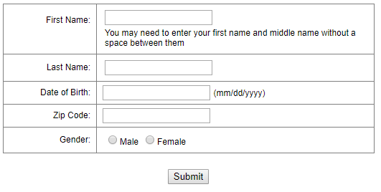
2025 Physician Screening Form
2025 Physician Screening Form Website
2025 Physician Screening Form
All boxes must be filled in to ensure the form is processed. If any information is missing, the form will not process automatically. We will reach out and require that all boxes are filled in and resubmitted before processing the form.

Slide 34
Closing: Site Coordinator Survey

Slide 35
Site Coordinator Survey
At the end of each month, Site Coordinators who hosted an onsite event will receive a link to complete a Site Coordinator Survey
This survey helps Sharecare to evaluate our job as your Event Specialist and allows us to provide process improvement recommendations for the following year.
Please ensure you complete the survey within the required time frame, providing honest and accurate feedback, as this will ensure we continue to provide quality service for your program.

Slide 36
Kyle Cheuvront E: BeWellSHBP.events@sharecare.com P: 615-614-4357
Be Well SHBP Member Services: 888-616-6411

