Slide 1
State Health Benefit Plan
Flu Site Coordinator Training Kyle Cheuvront TBD
Notes:
Introduce yourself and the training - Let them know Tiffany with Quest is on the call
Ask to hold questions until the end
Insure everyone mutes themselves and doesn’t place you on hold

Slide 2
Implementation Phases
Preparation
Roles & Responsibilities
Eligibility
Execution
Scheduling Flu Onsite Events
Participant Launch
Site Coordinator Onsite Preparation
Participant Flu Onsite Experience
Notes:
Introduce the presentation
Today we’ll be going over the different phases of hosting an onsite event: prep and execution

Slide 3
Preparation: Roles & Responsibilities
Notes:
We’ll start off with the different roles involved and what the responsibilities are for each role

Slide 4
Understanding Roles: Sharecare Event Specialist
Day-to-day point of contact for event-related questions
Responsibilities:
Work with vendors to establish expectations and ensure each implementation runs smoothly
Create and manage project timelines
Educate site coordinators on event implementation
Facilitate communication with our event partner, Quest Diagnostics
Communicate event-related information to site coordinators
Answer questions and assist with participant issues
Assess and confirm that each site is prepared to host an event
Notes:
Explain event specialist role
Again my name is Danielle and I am your Sharecare Event Specialist
I work with our vendor to make sure each event set up runs smoothly
I create and manage the project timelines, and educate site coordinators on the implementation process
I facilitate communication between our screening partner, Quest diagnostics, and the site coordinators
Answer questions and help with individual participant issues
As well as confirming that each site is prepared to host an event
My contact information is included on the last slide of the presentation so please feel free to reach out anytime with questions you may have

Slide 5
Understanding Roles: Site Coordinator
Site Coordinators serve as their location’s wellness leader by encouraging participants to become involved and excited about the Be Well SHBP® well-being program
Preparation
Submit request for scheduling via the webform and communicate with Quest via email to finalize event details
Reserve event location within facility
Execution
Encourage sign-ups
Print online scheduler sign-in sheet and provide to the Quest team before event
Note: Quest does not complete site visits before events
You are already promoting health and wellness by hosting a Flu shot event, so why not become a
Well-Being Ambassador? You will continue to promote healthy habits while also getting the chance to win
contests and awards and receive recognition for your efforts. To find out more about the program and to apply, visit www.BeWellSHBP.com
Notes:
Discuss roles of the site coordinator
The site coordinator helps encourage participation in the Be Well SHBP program
You will submit the request from the webform and work with Quest to finalize event details, as well as reserving a location at your site to hold the event
Encourage signups
Print sign in sheets
*May be different from previous years/vendors, but Quest does not complete site visits before events
If you are interested in becoming a Well-Being Ambassador, go to the BeWellSHBP website to find out more information about the program and apply

Slide 6
Understanding Roles: Onsite Screening Vendor – Quest Diagnostics
Quest Diagnostics
Contacts Site Coordinator to schedule event dates/times
Staffs Flu shot events with nurses
Brings all Flu shot supplies on the day of each event
Nurses
Attend onsite event to administer Flu vaccine
Notes:
Introduce Quest and explain their role
Quest diagnostics is our vendor partner for flu shots
The quest team will contact the SC to schedule and finalize event dates and times
They make sure there are enough staff and supplies for your event, and brings the flu shot supplies with them the day of the event
The Quest Nurses at the event administer the flu vaccine for the participants
Again, Tiffany from our Quest team is on the call today if you have any specific Quest questions at the end of the presentation

Slide 7
Preparation: Eligibility & Incentives

Slide 8
Eligibility & Incentives
Who’s Eligible?
The 2024 SHBP-Sponsored Flu shot onsite events are open to all SHBP members, and their covered spouses enrolled in Anthem Blue Cross and Blue Shield (Anthem) or UnitedHealthcare (non-Medicare Advantage) Plan Options.
Flu shot events do not apply to dependent children or members enrolled in Kaiser Permanente or Medicare Advantage Plan Options.
What’s the Incentive?
SHBP members can reduce the risk of absenteeism due to flu-related symptoms
Members can improve immunization rates within their population

Slide 9
Execution: Scheduling an Onsite Flu event

Slide 10
SHBP-sponsored Flu shot onsite events
Flu shot events will occur between September 17th-December 2nd, 2024
You must have 40 or more registered participants to host an event
Standard event hours: Monday-Friday 7:00am-7:00pm ET
Event dates, times and locations must be scheduled and confirmed prior to the event
Quest will provide nurses
One nurse can administer 15 shots per hour
The event hours and number of nurses depend on how much space is available and how many participants have scheduled appointments

Slide 11
Marketing – Event Support Documents
Marketing items can be found here:
www.BeWellSHBP.com/screenings-support
These include:
How to schedule document
Site Coordinator Training
Directional Arrow Signs
Event Room Signs
Notes:
Marketing items for promoting and preparing for your events can be found on the BeWell website. If you have any questions leading up to your event feel free to reach out to me. My email address is listed at the end of the presentation.

Slide 12
Execution: Participant Launch

Slide 13
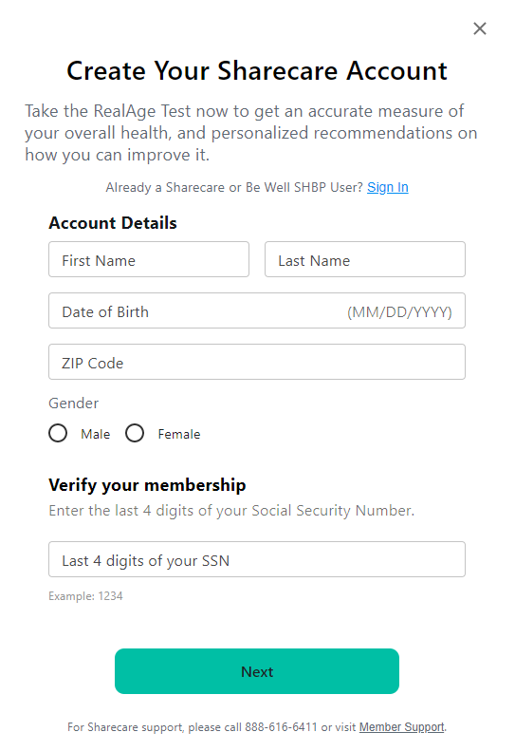
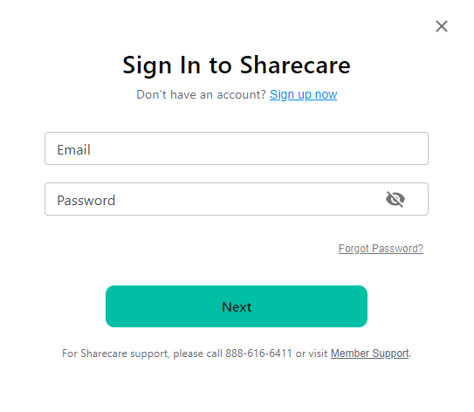
Accessing Quest Scheduler
Participant Login:
New Users: Register here
Existing Users: Log in here
Notes:
Participants will access the scheduler through the Sharecare platform.
If they are a new user they will need to register for an account
If they registered previously, they can sign in using the same credentials
These are live links that will take you to the registration and sign in pages, so feel free to refer back to this if you need to access the links

Slide 14
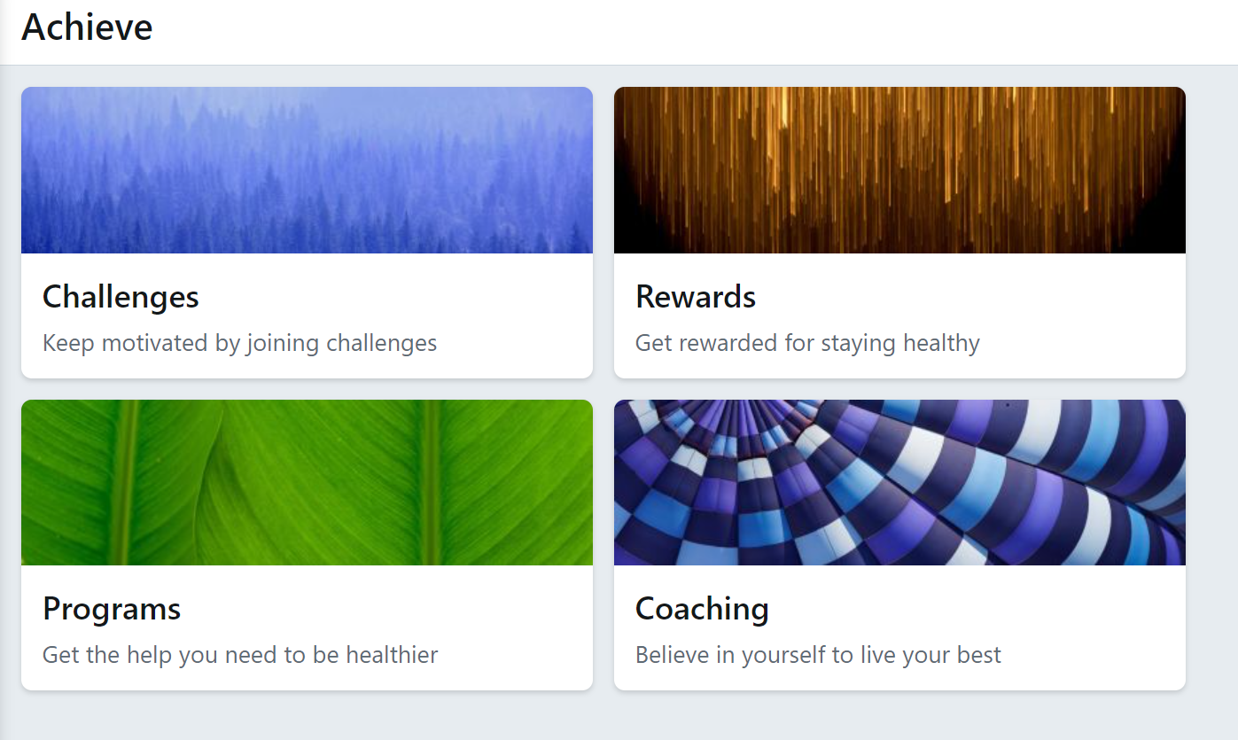
Accessing Quest Scheduler
Members can access the Quest Scheduler by logging into their Be Well SHBP account on the Sharecare Platform. Once logged in, select the achieve icon, and then the programs tile. Next select the health screening tile to be taken to the Quest online scheduler.
Notes:
Once they’ve signed in to their BeWell account on the Sharecare app or platform, they can access the Quest scheduler by selecting the Achieve icon, then the programs tile. The health screening tile will then show up and they will select that to be taken to the scheduler

Slide 15
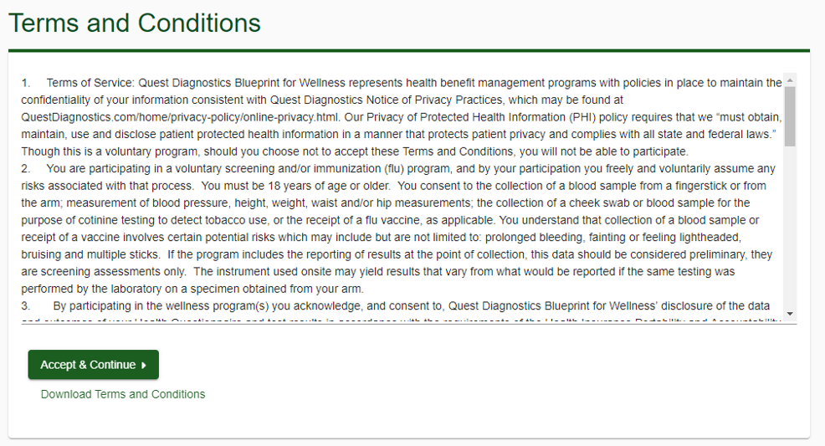
Quest Scheduler
Members will review the Terms and Conditions and click Accept & Continue

Slide 16
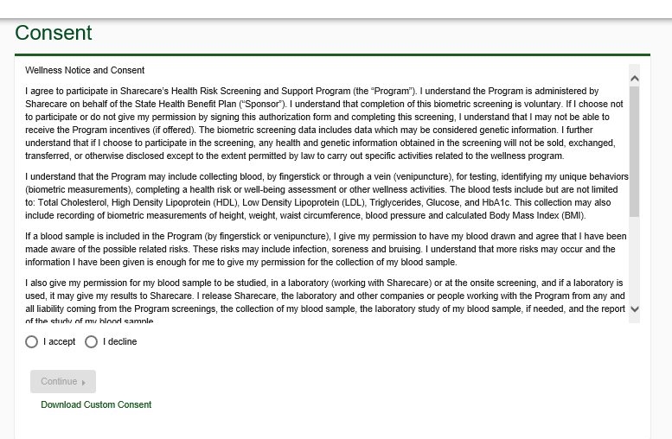
Quest Scheduler
Members will review the Consent, click I accept and then Continue

Slide 17
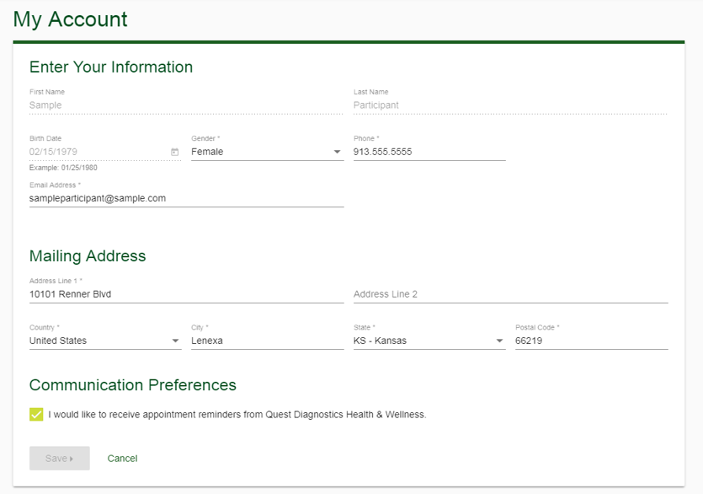
Quest Scheduler
Members will confirm all their information is correct, select their communication preferences, and click save

Slide 18
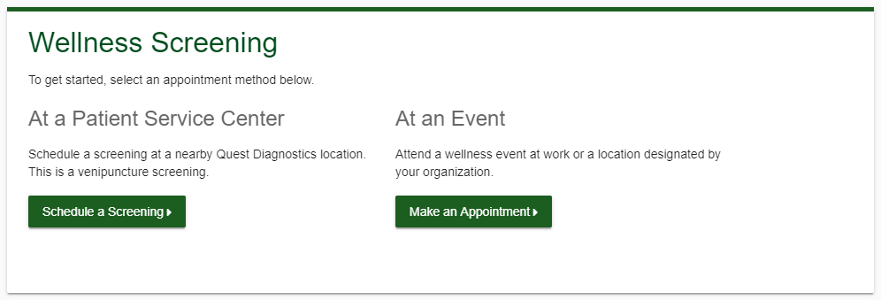
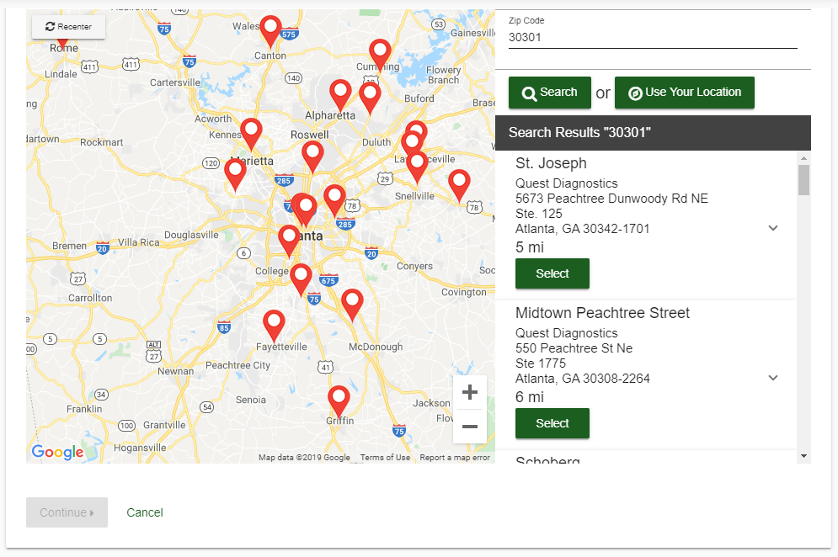
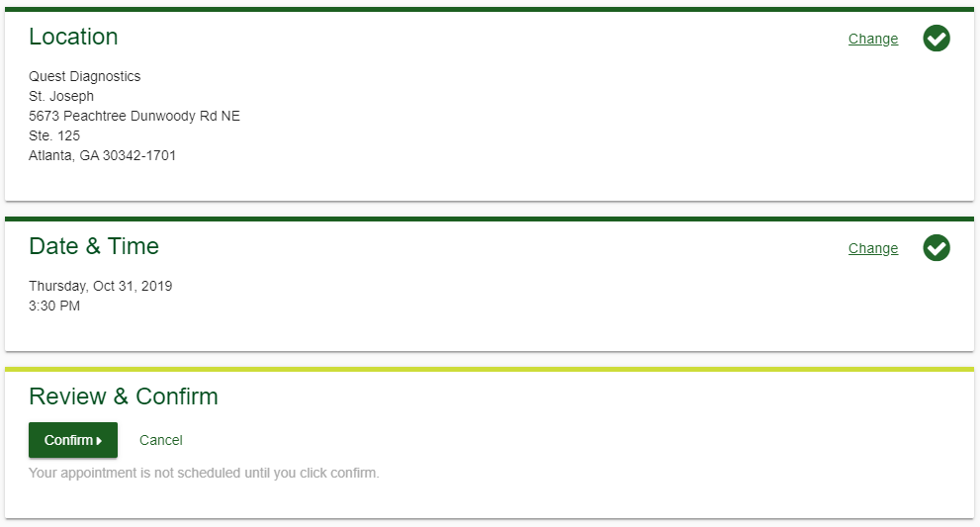
Quest Scheduler
After confirming their information is correct, participants will be taken to the Quest dashboard
Participants will click their desired Offering (Flu Shot) and follow the steps below:
Choose location and click “Continue”
Select date & time of appointment
Review selected appointment and click “Confirm”
Notes:
**Note the PSC is a venipuncture screening and Onsite is fingerstick

Slide 19
Lockdown Process
What is a Lockdown?
14 calendar days prior to each event, the number of appointments scheduled must be locked down
Confirms estimated number of participants
Why a Lockdown?
An accurate estimate of participants ensures appropriate amount of supplies and examiners for screenings
Key Points
SHBP-sponsored screening events will only be held at locations with 40 participants or more
If you have LESS than 40 scheduled appointments 3 weeks prior to your event, your Sharecare Event Specialist will notify you and ask that you help increase participation
If you estimate over 40, but have less than 40 scheduled appointments at the 14 calendar day lockdown, your event may be cancelled
Notes:
DANIELLE: Make sure you over-state that they can not change the estimate after the lockdown date. Tell them scheduling is still open until the day before, but they can’t change the estimate.

Slide 20
Execution: Site Coordinator Onsite Screening Preparation

Slide 21
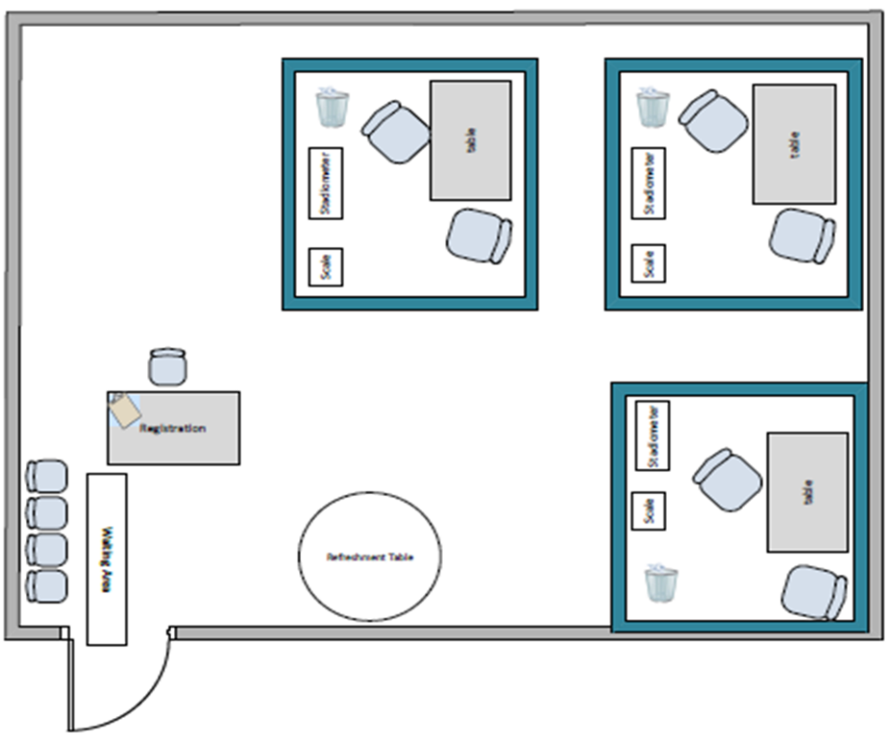
Day Before the Screening – Prepare Screening Area
Participant Registration Area
Outside but near the screening rooms
Table and chair for registration desk
Need 1 chair per examiner station
Exam Stations
Each examiner station will require a space of 8 ft. x 8 ft.
Day of event Screening Vendor arrives one (1) hour prior to start time to set up screening area
1 table, 2 chairs, and a trashcan for each exam station
Due to OSHA regulations, we cannot host screenings in a cafeteria if food is being prepared or consumed at the time of the screening

Slide 22
Day Before the Screening – Final Prep
Get your materials ready!
Ensure your registration and screening areas are set up appropriately
Ensure you have all the items ready to go the next morning
Prepare your screening sign-in sheets – make sure you bring them the morning of the screening – Your Sharecare Event Specialist will provide your final sign-in sheet the day before the event
Blue or Black Pens
Set reminders!
Set a reminder to arrive one (1) hour before screening start time the morning of your screening to greet the Quest event team and direct them to the screening area.
Notes:
Sign in sheets will be mailed to the site coordinator the week before your event. Please filter down to your location, print, and have ready for the Quest team when they arrive.

Slide 23
Walk-in Policy
We do not recommend walk-ins and ask that everyone signs up for their appointment in Quest’s Scheduling Tool
If a participant does wish to screen as a walk-in, they will take 2nd priority to those signed up
If someone arrives earlier than their scheduled appointment (more than 10 minutes before), they may be asked to return at their scheduled appointment time
Any participant who is a walk-in MUST bring their medical ID card to ensure we are screening only those who are eligible
Notes:
**DANIELLE: Bring up If you anticipate walk-ins, they need to be accounted for in your final estimate on the lockdown date!!**
If a participant does wish to screen as a walk-in, they will take 2nd priority to those with a scheduled appointment
The registration clerk may find an open appointment time and ask them to return at that time to be screened.
This ensures that there are no more than 10 people in the event area at a time

Slide 24
Site Coordinator Survey
At the end of each month, Site Coordinators who hosted an onsite event will receive a link to complete a Site Coordinator Survey
This survey helps Sharecare to evaluate our job as your Event Specialist and allows us to provide process improvement recommendations for the following year.
Please ensure you complete the survey within the required time frame, providing honest and accurate feedback, as this will ensure we continue to provide quality service for your program.

Slide 25
Kyle Cheuvront E: BeWellSHBP.events@sharecare.com P: 615-614-4357
Be Well SHBP Member Services: 888-616-6411
Notes:
Danielle: Update to your name and teams number

